Slide 1
CHEM 2222 – Week 4
Activities:
  Oxidation of benzoin to benzil
  Conversion of stilbene dibromide to dephenylacetylene by two elimination reactions

Slide 2
Oxidation of Benzoin to Benzil

Slide 3
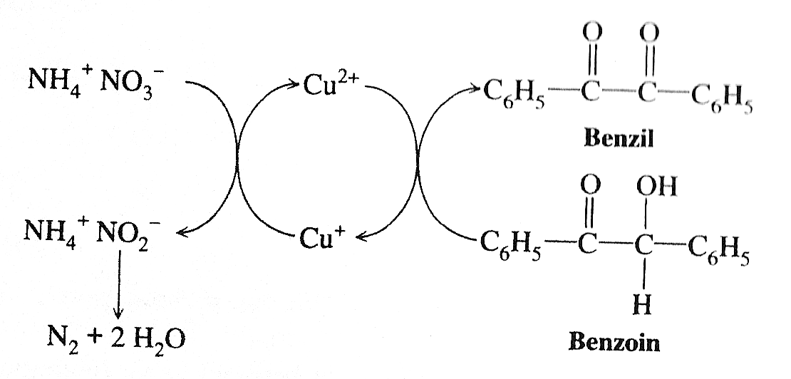
Mechanism as simplified by your book

Slide 4
Oxidation of alcohols usually occurs through an “ester” of some kind
“ester”
M could be many different elements including some metals
The oxidation occurs here with the transfer of the electrons in red

Slide 5
In our case, we are dealing with a nitrate ester
Nitrate ester

Slide 6
Nitrate ester is not a strong enough oxidizing agent
Under the conditions of the reaction, the nitrate ester is not strong enough oxidizing agent to permit the proton to be abstracted by the bases available (NH₃ or H₂O, or acetate) in the system to force the transfer of the electrons to the N atom.

Slide 7
Role of copper acetate – part 1
This is Cu(II) acetate
This ‘copper(II) nitrate’ ester is a strong enough oxidizing agent because of the driving force to go to Cu(I).

Slide 8
The oxidation
On this side, each copper is Cu(II)
This is Cu(I) acetate
In effect, the two electrons in the red bond get transferred, one each, to the two Cu(II) atoms to make them Cu(I).
The base could also be NH₃ or acetate.

Slide 9
Restoration of Cu(II) catalyst
This is Cu(II) acetate
from air
This is Cu(I) acetate
O₂^{- .}
superoxide

Slide 10
Formation of N₂ from NO₂⁻
Involves another series of reactions unrelated to the oxidation

Slide 11
Experimental details
A “gas trap” is not necessary.
Recrystallization is not necessary.
Safety:
  Glacial acetic acid can cause a significant chemical burn, but may not be noticed immediately on the skin, since it is classified as a “weak acid”
    Use gloves; avoid inhalation
  Ammonium nitrate is classified as a strong oxidizer that can cause fire.
    Avoid contact or breathing dust
    Use gloves
  Benzoin – See MSDS regarding potential damaging DNA effect
    Use gloves
    avoid contact or breathing dust
  Benzil – See MSDS; serious corrosive eye injury possible
    Use gloves
    avoid contact or breathing dust

Slide 12
Diphenylacetylene from Stilbene Dibromide

Slide 13
Two steps
TEG = triethylene glycol

Slide 14
Comparison of relative expected proton acidities
Much more acidic
Bromine on same carbon inductively stabilizes formation of anion.
Anion also stabilized by resonance delocalization into benzene ring.
Much less acidic
Electron withdrawing bromine only on neighboring carbon; less stabilizing of anion.
Anion exists in sp² bonding orbital; not delocalized as easily into benzene ring; expected resonance delocalization is less.

Slide 15
You need a strong base for the second step
KOH may not be strong enough for the second step.
However, KOH reacts with your solvent, TEG, to produce a stronger base:

Slide 16
Second Step Elimination
Even with the stronger base, this second step is much slower, and may require more heating.

Slide 17
Hazards
KOH is a strong base and can cause serious skin and eye injuries.
  Solid KOH is hygroscopic and will rapidly absorb moisture from the air.
    Weigh quickly, as the weight will change with time as moisture is absorbed.
    Clean all surfaces exposed to solid KOH as the residue will absorb moisture and produce hazardous spots at locations where you leave the solid.
The reaction mixture produces a stronger base, by reaction with TEG, which is hazardous.
This reaction has to be heated to a high temperature.
  Hot glassware can produce serious thermal burns.
  The hot reaction mixture is MUCH more hazardous to skin and eyes.
    The room temperature mixture is still HIGHLY hazardous, and will produce serious chemical burns.
  Use great care:
    To avoid spilling the hot reaction mixture on you.
    To avoid overheating; absolute maximum temperature is 185º C.
    Never look directly into the mouth of the flask.
As always, make sure you are wearing safety goggles.

Slide 18
Work up
You do not need to recrystallize.

Slide 19
end

